Slide 1
Consumption
and
Investment

Slide 2
Income, Consumption and Saving LO 1
Consumption and saving
  Primarily determined by DI
  Direct relationship
Consumption schedule
  Planned household spending (in our model)
Saving schedule
  DI minus C
  Dissaving can occur
Notes:
DI represents disposable income (after-tax income) and is the most important determinant of C (consumption spending). What is not spent is called saving. Both consumption and saving are directly related to the level of income.
We can make the following conclusions:
Households consume a large portion of their disposable income and spend a larger proportion of a small disposable income than of a large disposable income.
Households save a smaller proportion of a small disposable income than of a large disposable income.
Dissaving is consuming in excess of disposable income. Households dissave by borrowing or by selling accumulated wealth (assets).

Slide 3
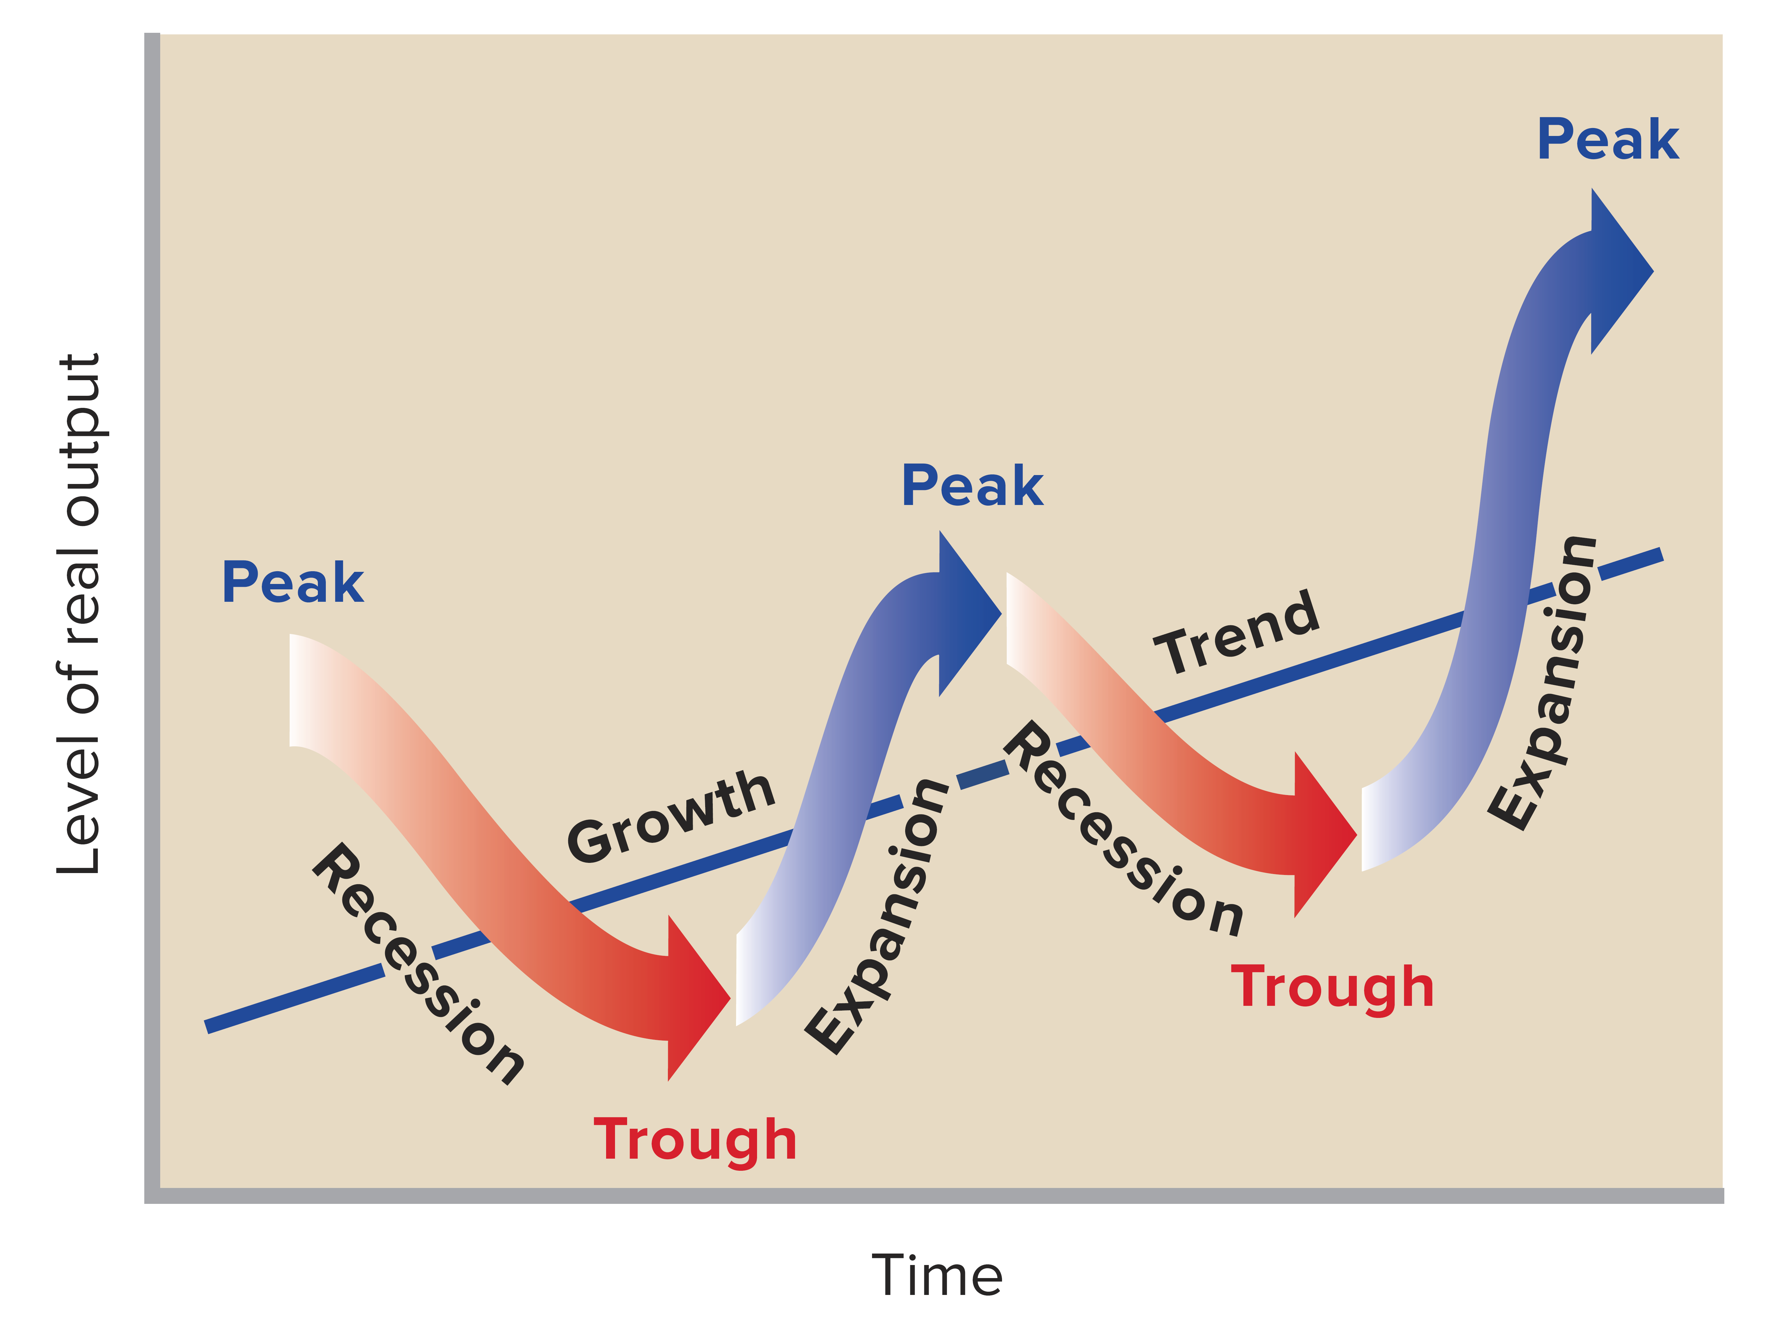
The Business Cycle 2 of 3
LO 1
Notes:
This figure shows the business cycle. Economists distinguish four phases of the business cycle; the duration and strength of each phase may vary. Additionally, individual cycles vary in duration and intensity. You can see that the long run trend is economic growth. Business cycles are alternating rises and declines in the level of economic activity, sometimes over several years. Individual cycles (one “up” followed by one “down”) vary substantially in duration and intensity.
four phases of a generalized business cycle: ∙ At a peak, such as the middle peak shown in Figure 9.1, business activity has reached a temporary maximum. Here the economy is near or at full employment and the level of real output is at or very close to the economy’s capacity. The price level is likely to rise during this phase.
A recession is a period of decline in total output, income, and employment. This downturn, which lasts 6 months or more, is marked by the widespread contraction of business activity in many sectors of the economy. Along with declines in real GDP, significant increases in unemployment occur. In the trough of the recession or depression, output and employment “bottom out” at their lowest levels. The trough phase may be either short-lived or quite long. A recession is usually followed by a recovery and expansion, a period in which real GDP, income, and employment rise. At some point, the economy again approaches full employment.

Slide 4
Consumption
Why are we interested in national consumption and saving trends?
Consumption behavior is crucial for understanding both short-term business cycles and long term economic growth. In the short run, consumption is a major component of aggregate spending.
When consumption changes sharply, the change is likely to affect output and employment through its impact on aggregate demand. This mechanism will be described in the chapters on Keynesian macroeconomics.
Additionally, consumption behavior is crucial because what is not consumed—that is, what is saved is available to the nation for investment in new capital goods; capital serves as a driving force behind long-term economic growth. Consumption and saving behavior are key to understanding economic growth and business cycles.

Slide 5
Budgetary Expenditure Patterns
No two families spend their disposable incomes in exactly the same way. Yet statistics show that there is a predictable regularity in the way people allocate their expenditures among food, clothing, and other major items.
Poor families must spend their incomes largely on the necessities of life: food and shelter.
As income increases, expenditure on many food items goes up. People eat more and eat better. There are, however, limits to the extra money people will spend on food when their incomes rise. Consequently, the proportion of total spending devoted to food declines as income increases.

Slide 6
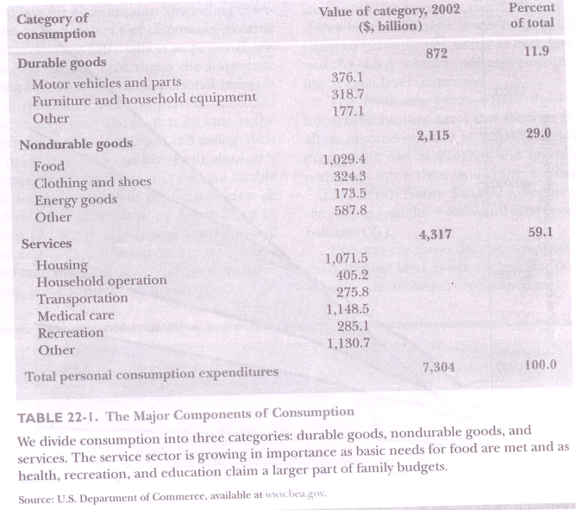
TABLE 22- I . The Major Components of Consumption

Slide 7
Cont.,
"Engel's Laws” : The average behavior of consumption expenditure does change fairly regularly with income.

Slide 8
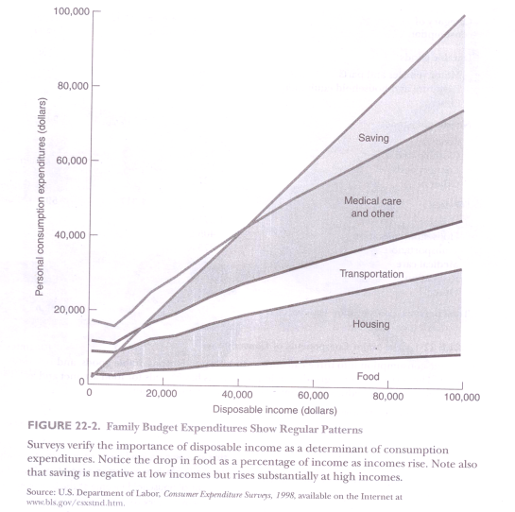
FIGURE 22-2. Family Budget Expenditures Show Regular Pattern

Slide 9
Consumption, Income and Saving
Income, consumption, and saving are all closely linked. More precisely, personal saving is that part of disposable income that is not consumed; saving equals income minus consumption.
Economic studies have shown that income is the primary determinant of consumption and saving. Rich people save more than poor people, both absolutely and as a percent of income. The very poor are unable to save at all. Instead, as long as they can borrow or draw down their wealth, they tend to dis save.
That is, they tend to spend more than they earn, reducing their accumulated savings or going deeper into debt.

Slide 10
The Consumption Function
One of the most important relationships in all macroeconomics is the consumption function. The consumption function shows the relationship between the level of consumption expenditures and the level of disposable personal income.
This concept, introduced by Keynes, is based on the hypothesis that there is a stable empirical relationship between consumption and income.

Slide 11
Consumption and Disposable Income LO 1
Notes:
This figure shows the consumption and disposable income for the U.S. for 1993-2015. Each dot in this figure shows consumption and disposable income in a specific year. The line, C, which generalizes the relationship between consumption and disposable income, indicates a direct relationship and shows that households consume most of their after-tax incomes.
This figure represents graphically the recent historical relationship between disposable income (DI), consumption (C), and saving (S) in the United States.
A 45-degree line represents all points where consumer spending is equal to disposable income. Other points represent actual C, DI relationships for each year.
If the actual graph of the relationship between consumption and income is below the 45-degree line, then the difference must represent the amount of income that is saved. Notice that consumption can exceed disposable income and personal saving can be negative.

Slide 12
Consumption and Saving Schedules 1 of 2 LO 1
Consumption and Saving Schedules (in Billions) and Propensities to Consume and Save
(1) Level of Output and Income GDP = DI | (2) Consumption (C) | (3) Saving (S), (1) - (2) | (4) Average Propensity to Consume (APC), (2)/(1) | (5) Average Propensity to Save (APS), (3)/(1) | (6) Marginal Propensity to Consume (MPC), Δ(2)/Δ(1)* | (7) Marginal Propensity to Save (MPS), Δ(3)/Δ(1)*
(1) $370 | $375 | $-5 | 1.01 | -.01 | .75 | .25
390 | 390 | 0 | 1.00 | .00 | .75 | .25
410 | 405 | 5 | .99 | .01 | .75 | .25
430 | 420 | 10 | .98 | .02 | .75 | .25
450 | 435 | 15 | .97 | .03 | .75 | .25
470 | 450 | 20 | .96 | .04 | .75 | .25
490 | 465 | 25 | .95 | .05 | .75 | .25
510 | 480 | 30 | .94 | .06 | .75 | .25
530 | 495 | 35 | .93 | .07 | .75 | .25
(10) 550 | 510 | 40 | .93 | .07 | .75 | .25
Notes:
This table shows the consumption and saving schedules and propensities to consume and save (propensities to consume and save will be presented in later slides).
This hypothetical consumption schedule shows that households spend a larger proportion of a small income than of a large income based on the APC. Note that “dissaving” occurs at low levels of disposable income, where consumption exceeds income and households must borrow or use up some of their wealth.
The break-even income is where C = DI and S = 0. In this table, the break-even income occurs when DI = $390.

Slide 13
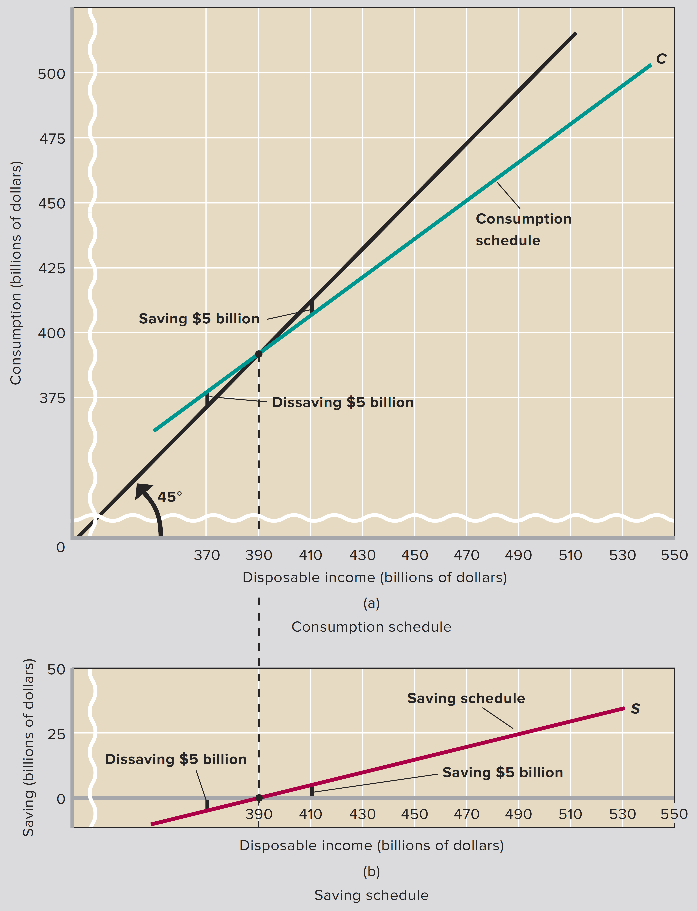
Consumption and Saving Schedules 2 of 2
LO1
Notes:
This figure shows (a) consumption and (b) saving schedules. The two parts of this figure show the income-consumption and income-saving relationships graphically. The saving schedule in (b) is found by subtracting the consumption schedule in (a) vertically from the 45° line. Consumption equals disposable income (and saving, thus, equals zero) at $390 billion for this hypothetical data.

Slide 14
The “Break-Even” Point
The "Break-Even" Point. To understand the figure, it is helpful to look at the 45° line drawn northeast from the origin. Because the vertical and horizontal axes have exactly the same scale, the 45° line has a very special property. At any point on the 45° line, the distance up from the horizontal axis (consumption) exactly equals the distance across from the vertical axis (disposable income). You can use your eyes or a ruler to verify this fact.
The 45° line tells us immediately whether consumption spending is equal to, greater than, or less than the level of disposable income. The break-even point on the consumption schedule that intersects the 45° line represents the level of disposable income at which households just break even.

Slide 15
Cont.,
At any point on the 45° line, consumption exactly equals income and the household has zero saving.
When the consumption function lies above the 45° line, the household is dissaving.
When the consumption function lies below the 45° line, the household has positive saving. The amount of dissaving or saving is always measured by the vertical distance between the consumption function and the 45° line.

Slide 16
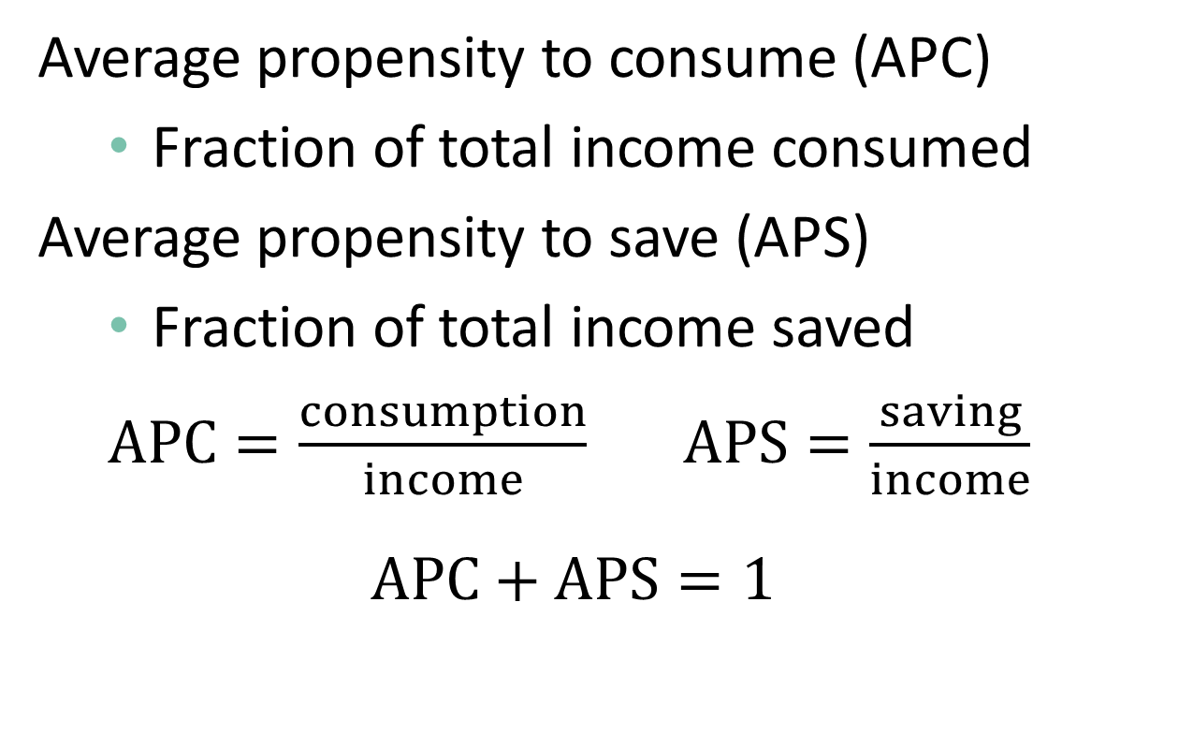
Average Propensities LO 1
Average propensity to consume (APC)
  Fraction of total income consumed
Average propensity to save (APS)
  Fraction of total income saved
  $APC=\frac{consumption}{income}$ $APS=\frac{saving}{income}$
  $$APC+APS=1$$
Notes:
The definition of the average propensity to consume (APC) is the fraction, or percentage, of income consumed (APC = consumption/income). If you multiply the fraction by 100 you can express this as a percentage. The definition of the average propensity to save (APS) is a the fraction, or percentage, of income saved (APS = saving/income). If you multiply the fraction by 100 you can express this as a percentage.

Slide 17
The Marginal Propensity to Consume
The MPC is the extra amount that people consume when they receive an extra dollar of disposable income.
The word “marginal” is used throughout economics to mean extra or additional.
For example “marginal Cost” means the additional cost of producing an extra unit of output.
“Propensity to consume” designates the level of consumption.
The MPC is therefore the additional or extra consumption that result from an extra dollar disposable income.

Slide 18
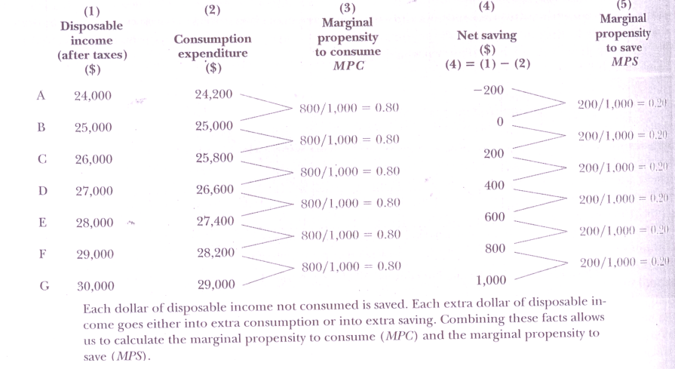
MPC and MPS

Slide 19
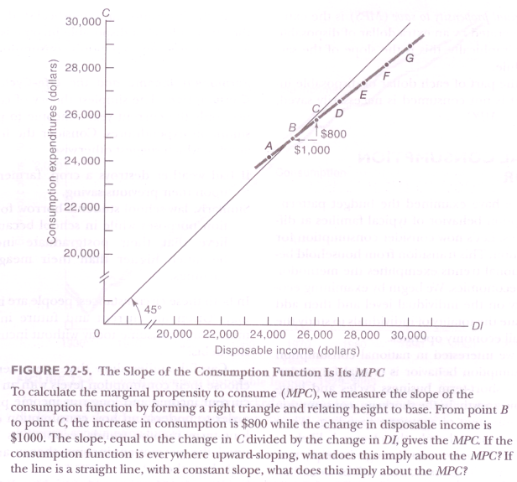
FIGURE 22-5. The Slope of the Consumption Function Is Its MPC

Slide 20
The Marginal Propensity to SAVE
The Slope of the Consumption Function is its MPC.
The marginal propensity to save is defined as the fraction of an extra dollar of disposable income that goes to extra saving.
Recall that disposable income equals consumption plus saving. This implies that each extra dollar of disposable income must be divided between extra consumption and extra saving. Thus if MPC is 0.80, then MPS must be 0.20. (What would MPS be if MPC were O.6? Or O.99?) Comparing columns (3) and (5) of of last table confirms that at any income level, MPC and MPS must always add up to exactly 1, no more and no less. MPS + MPC = 1, always and everywhere.

Slide 21
Brief Review of Definitions:
The consumption functions relates the level of consumption to the level of disposable income.
The saving function relates saving to disposable income. Because what is saved equals what is not consumed, saving and consumption schedules are mirror images.
The MPC is the amount of extra consumption generated by an extra dollar of disposable income. Graphically, it is given by the slope of the consumption function.
The ‘MPS is the extra saving generated by an extra dollar of disposable income. Graphically, this is the slope of the saving schedule.
Because the part of each dollar disposable income that in not. Consumed is necessarily saved. MPS = 1 - MPC

Slide 22
NATIONAL CONSUMPTION BEHAVIOR
Up to now we have examined the budget patterns and consumption behavior of typical families at different incomes, Let’s now consider consumption for the entire nation. This transition from household behavior to national trends exemplifies the methodology of macroeconomics. We begin by examining economic activity on the individual level and then add up or aggregate the totality of individuals to study the way the overall economy operates.

Slide 23
Permanent Income and the Life-Cycle Model of Consumption.
Studies show that consumers generally choose their consumption levels with an eye to both current income and long-run income prospects.
In order to understand how consumption depends on long—term income trends, economists have developed the permanent-income theory and the life- cycle hypothesis.

Slide 24
Permanent Income:
Permanent income is the trend level of income that is, income after removing temporary or transient influences due to the weather or windfall gains or losses.
If a change in income appears permanent (such as being promoted to a secure and high-paying job), people are likely to consume a large fraction of the increase in income.
On the other hand, if the income change is clearly transitory (for example, if it arises from a one-time bonus or a good harvest), a significant fraction of the additional income may be saved.

Slide 25
Life cycle Hypothesis
The life-cycle hypothesis assumes that people save in order to smooth their consumption over their lifetime. One important objective is to have an adequate retirement income.
One implication of the life-cycle hypothesis is that a program like social security, which provides a generous income supplement for retirement, will reduce saving by middle—aged workers since they no longer need to save as much for retirement.

Slide 26
Wealth and Other Influence
One important historical case was the stock market crash after 1929, when fortunes collapsed and paper—rich capitalists became paupers overnight. Economic historians believe that the sharp decline in wealth after the 1929 stock market crash reduced consumption pending and contributed to the depth of the Great Depression.

Slide 27
Alternative Measures of Saving
Saving looks different to the household than to the nation as a whole. This is so because saving as measured in the national income and product accounts is not the same as that measured by accountants or in balance sheets. The national-accounts measure of saving is the difference between disposable income (excluding capital gains) and consumption.
The balance sheet measure of saving calculates the change in real net worth (that is, assets less liabilities, corrected for inflation) from one year to the next; this measure includes real capital gains.

Slide 28
Global Perspective 1 LO 1
Notes:
This Global Perspective shows the average propensities to consume for selected nations. There are surprisingly large differences in the average propensities to consume (APCs) among nations. In 2014, Canada and the United States, in particular, had substantially higher APCs, and thus lower APSs, than several other advanced economies.
Note the high APCs for Korea, the U.S., and Canada.
Note that APC + APS = 1.

Slide 29
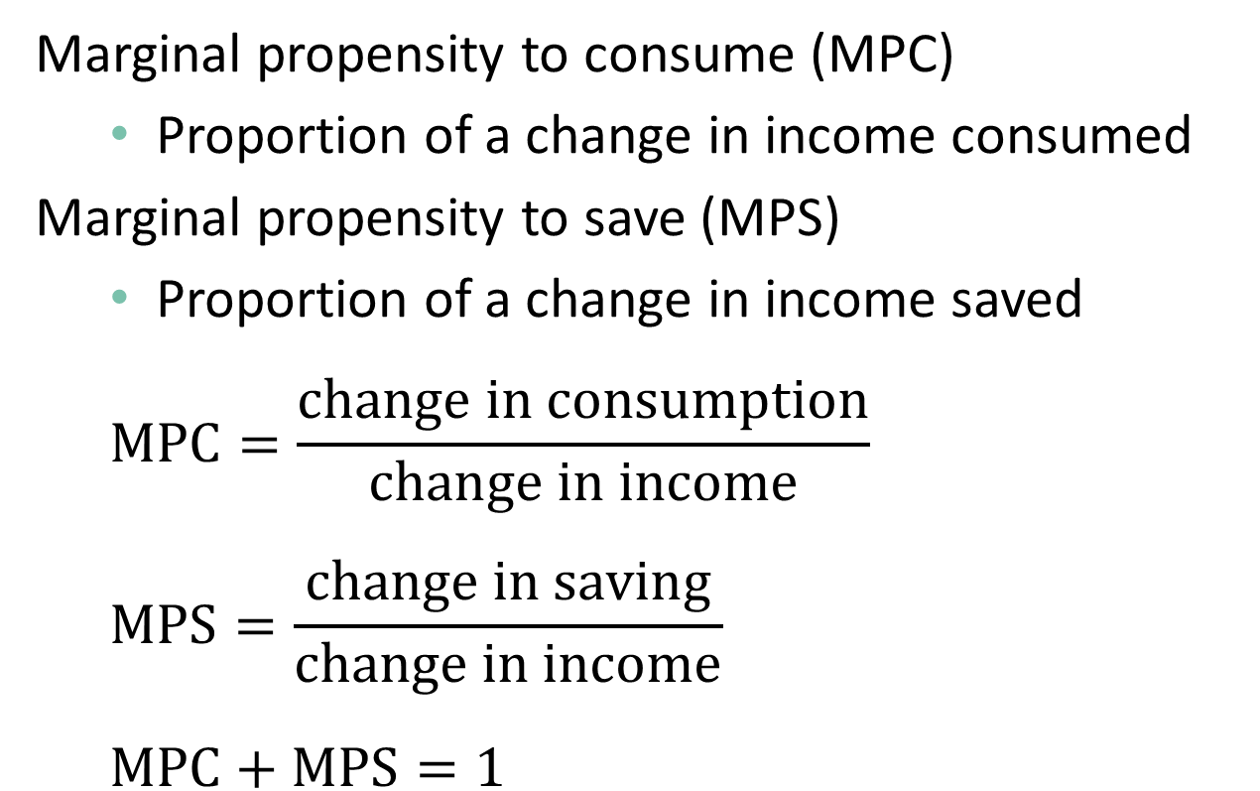
Marginal Propensities 1 of 2
LO 1
Marginal propensity to consume (MPC)
  Proportion of a change in income consumed
Marginal propensity to save (MPS)
  Proportion of a change in income saved
  $$MPC=\frac{change in consumption}{change in income}$$
  $$MPS=\frac{change in saving}{change in income}$$
  $$MPC+MPS=1$$
Notes:
Marginal propensity to consume (MPC) is the fraction or proportion of any change in income that is consumed. (MPC = change in consumption/change in income.) Marginal propensity to save (MPS) is the fraction or proportion of any change in income that is saved. (MPS = change in saving/change in income.) Note that MPC + MPS = 1.

Slide 30
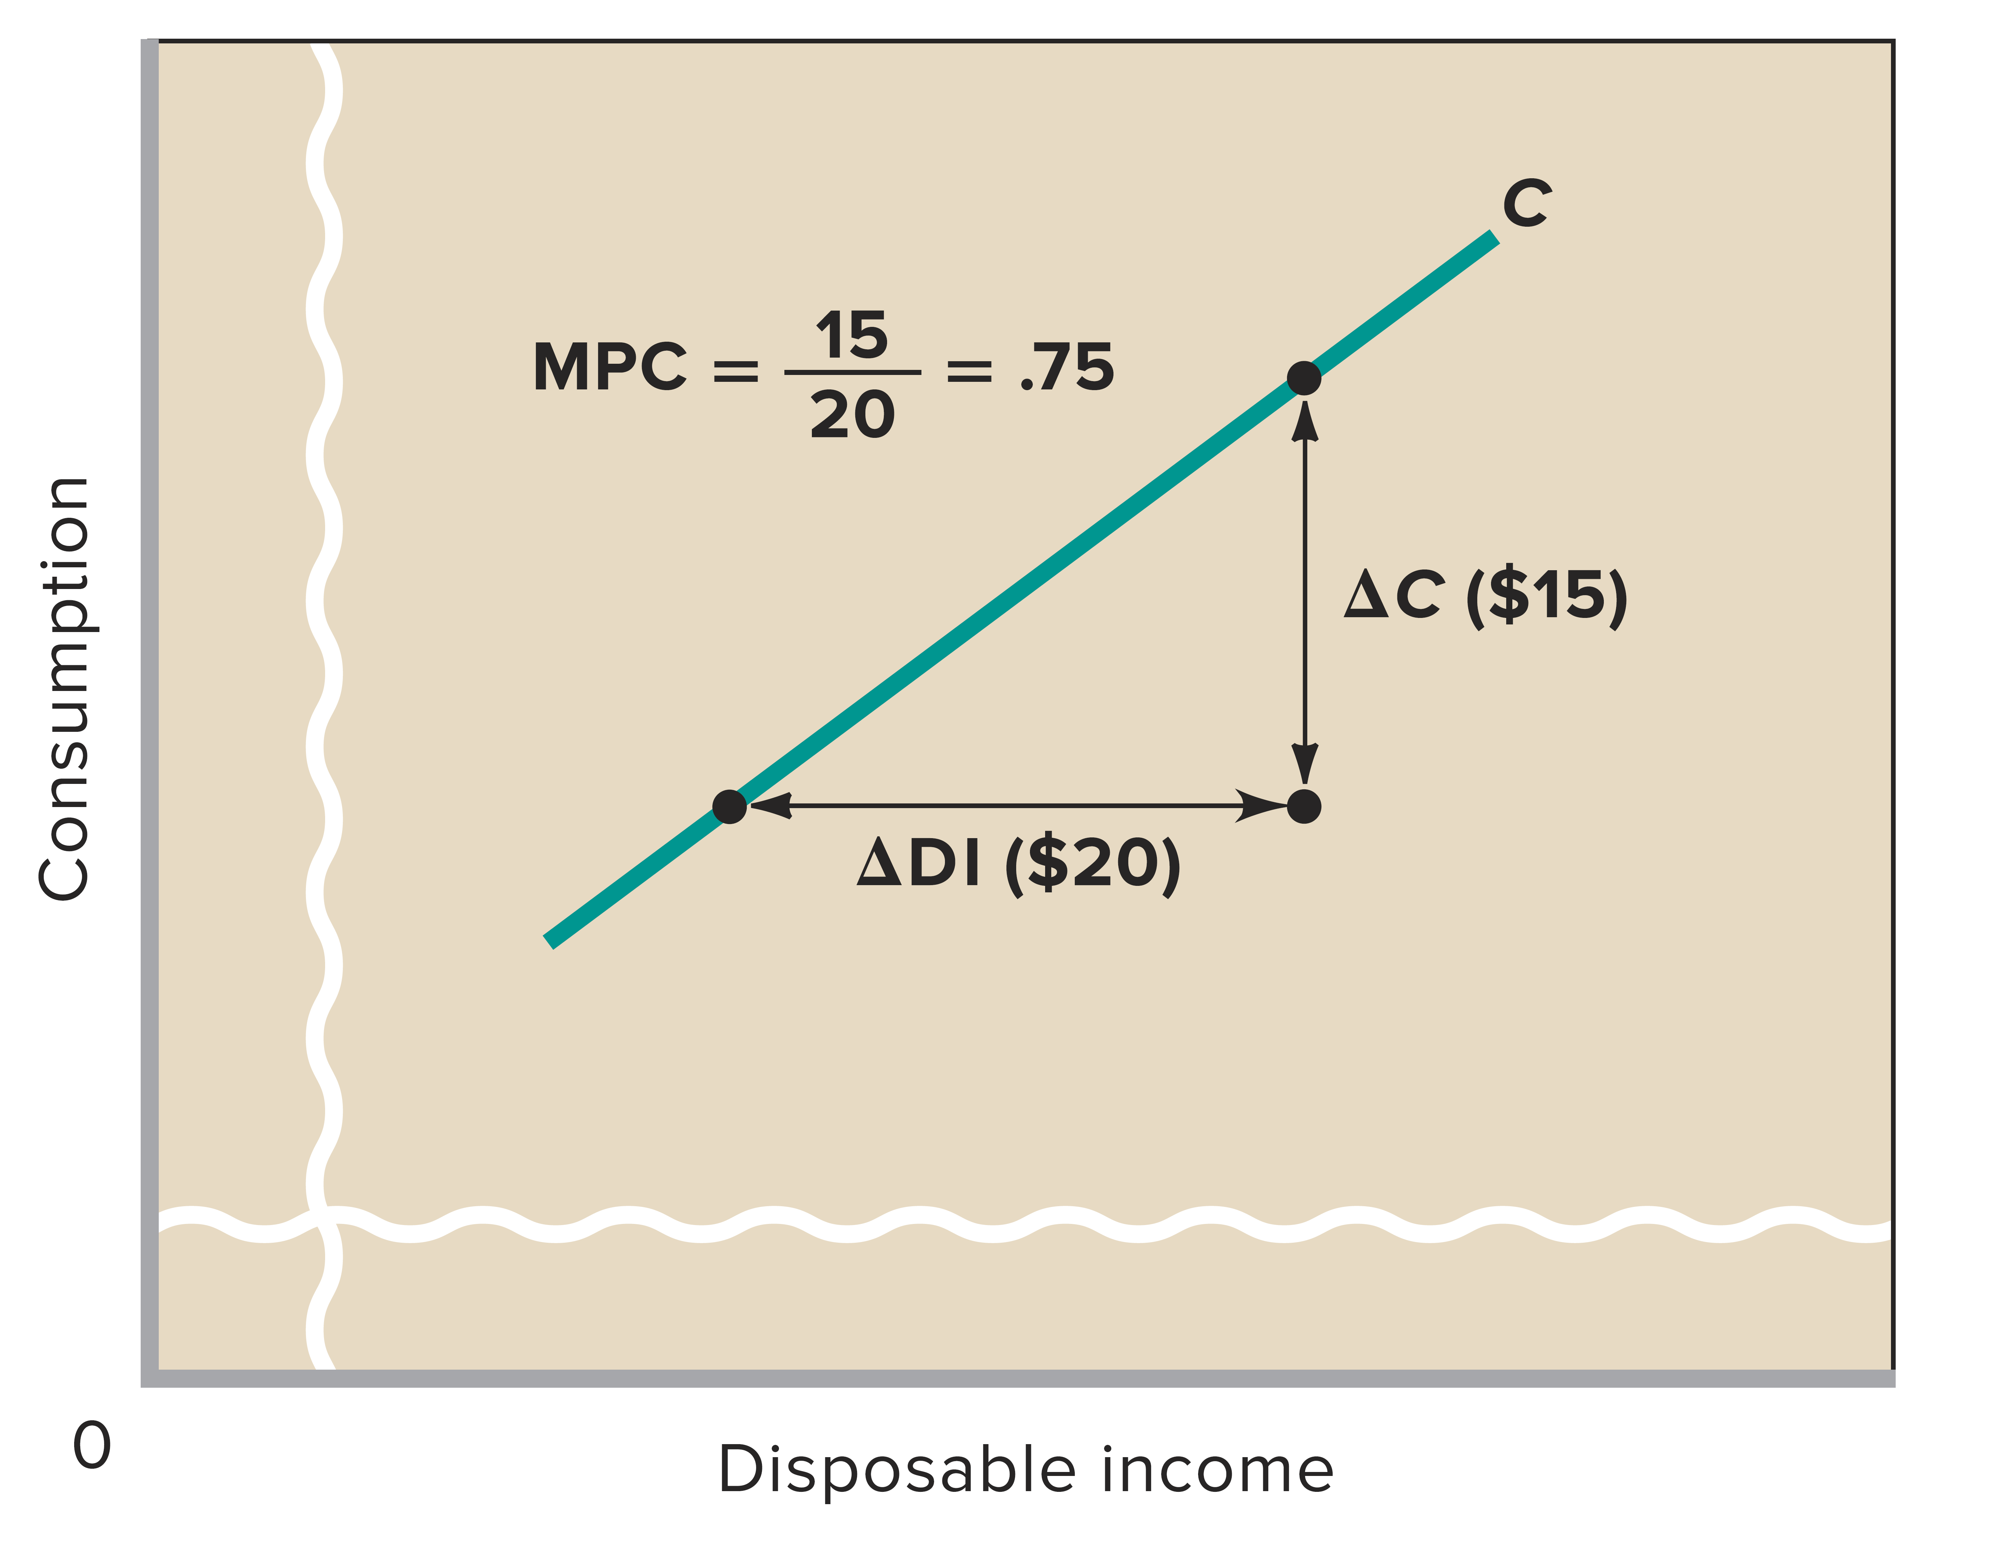
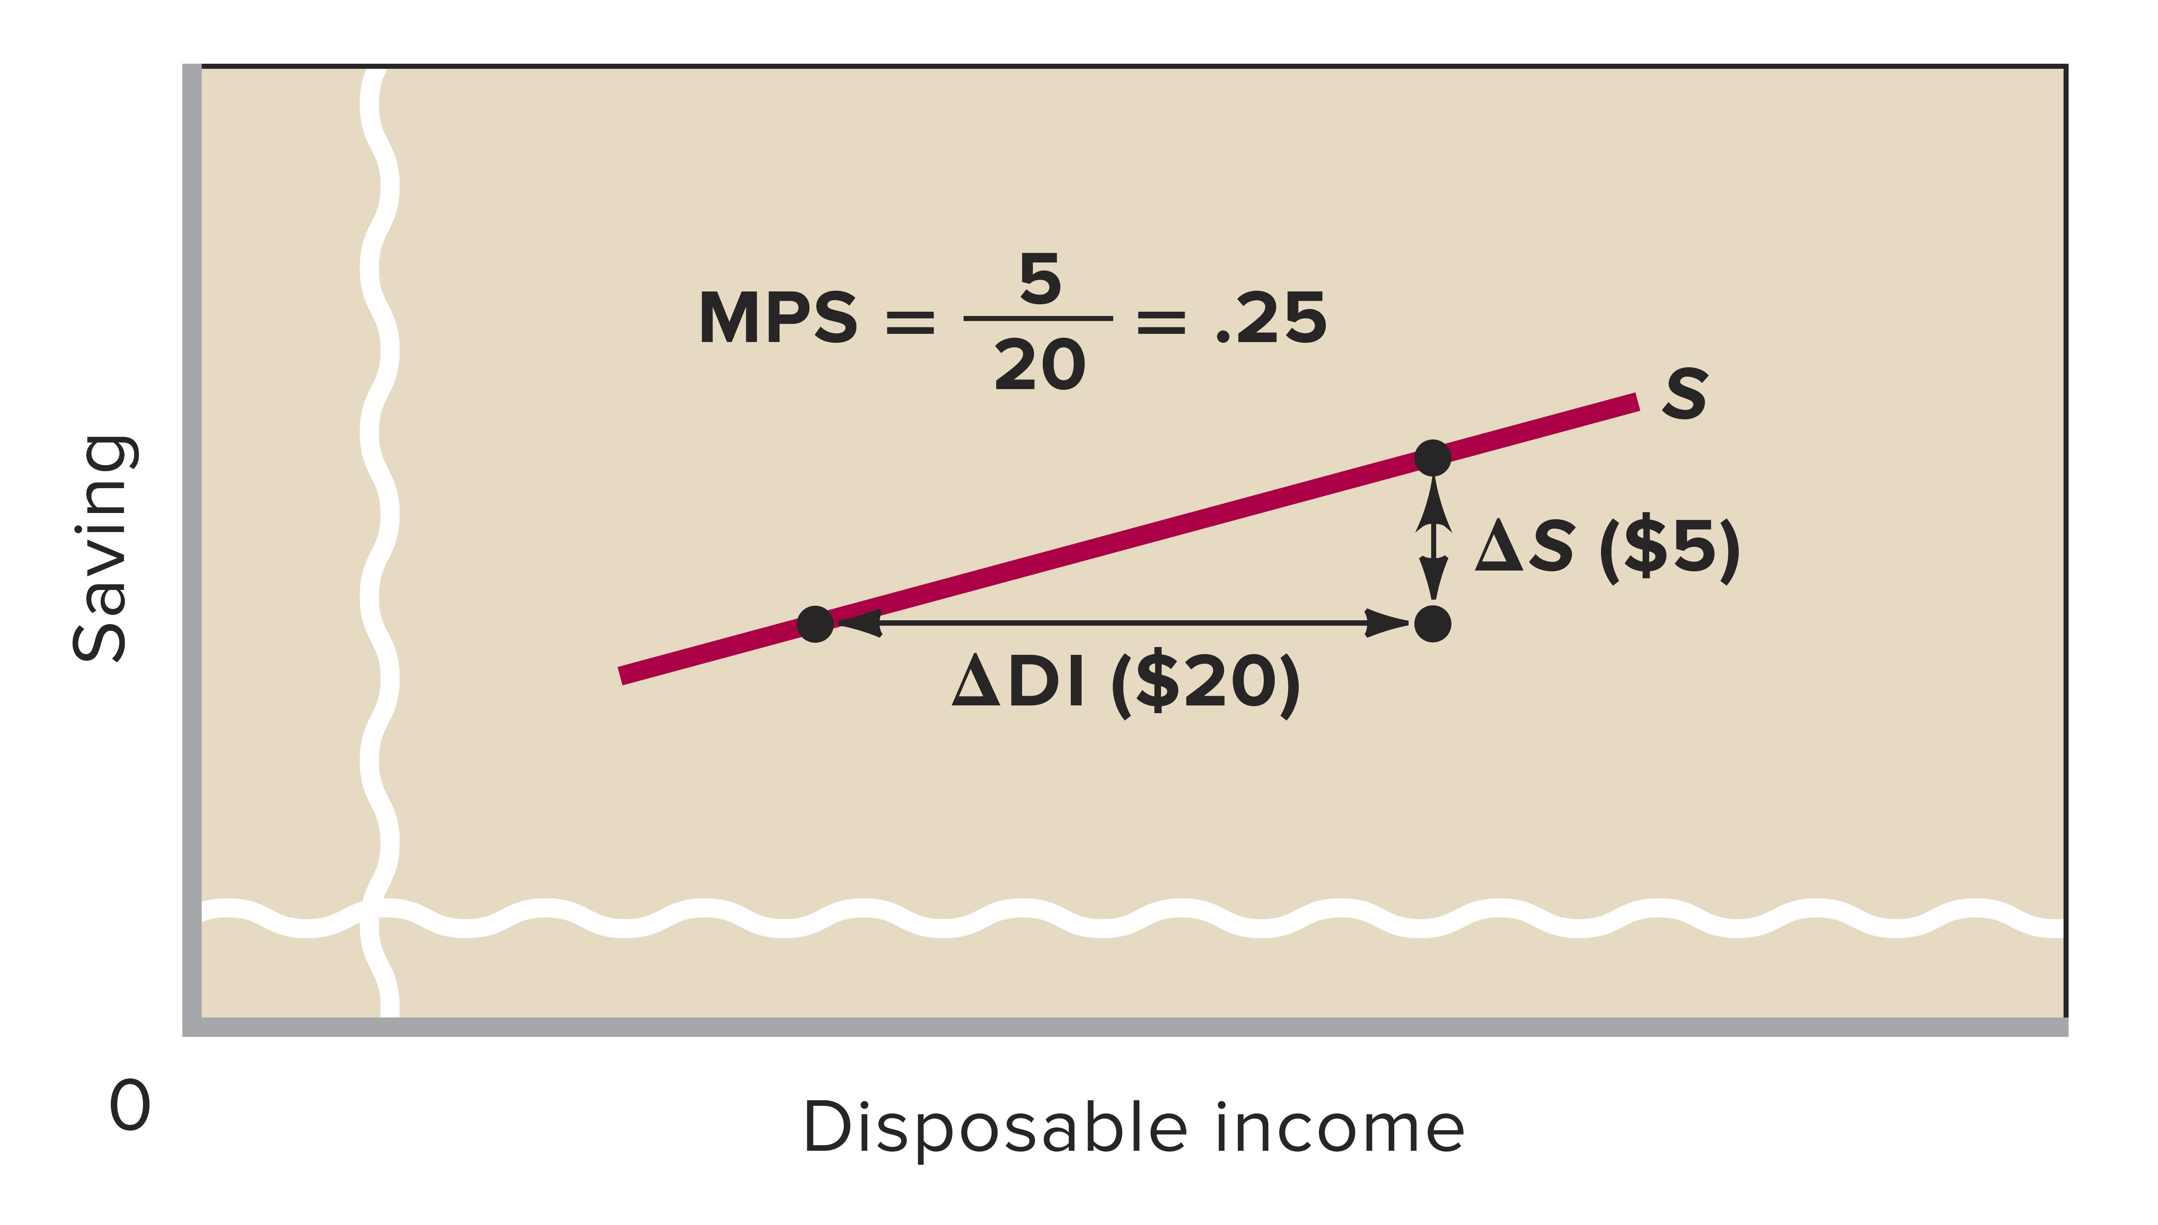
Marginal Propensities 2 of 2
LO 1
Notes:
This figure shows the marginal propensity to consume and the marginal propensity to save as the slopes of the consumption and savings schedules. The MPC is the slope of the consumption schedule and the MPS is the slope of the saving schedule. The Greek letter delta means “the change in.”

Slide 31
Nonincome Determinants LO 2
Amount of disposable income is the main determinant
Other determinants
  Wealth
  Borrowing
  Expectations
  Real interest rates
Notes:
Nonincome determinants of consumption and saving can cause people to spend or save more or less at various income levels, although the level of income is the basic determinant.
Wealth: An increase in wealth shifts the consumption schedule up and the saving schedule down. In recent years, major fluctuations in stock market values have increased the importance of this wealth effect. A “reverse wealth effect” occurred in 2000 and 2001 when stock prices fell dramatically.
Household debt: Lower debt levels shift the consumption schedule up and the saving schedule down.
Expectations: Changes in expected future prices or wealth can affect consumption spending today.
Real interest rates: Declining interest rates increase the incentive to borrow and consume, and reduce the incentive to save. Because many household expenditures are not interest sensitive — the electric bill, groceries, etc. — the effect of interest rate changes on spending are modest.

Slide 32
Nonincome Determinants
Wealth: A household’s wealth is the dollar amount of all the assets that it owns minus the dollar amount of its liabilities (all the debt that it owes). Households build wealth by saving money out of current income. wealth effect shifts the consumption schedule upward and the saving schedule downward.

Slide 33
Borrowings: Household borrowing also affects consumption. When a household borrows, it can increase current consumption .By allowing households to spend more, borrowing shifts the current consumption schedule upward.
Stated a bit differently, increased borrowing increases debt (liabilities), which in turn reduces household wealth (since wealth = assets − liabilities). This reduction in wealth reduces future consumption possibilities in much the same way that a decline in asset values would.

Slide 34
Expectations: Household expectations about future prices and income may affect current spending and saving. For example, the expectation of higher prices tomorrow may cause households to buy more today while prices are still low. Thus, the current consumption schedule shifts up and the current saving schedule shifts down.
Or expectations of a recession and thus lower income in the future may lead households to reduce consumption and save more today.

Slide 35
Real interest rates: When real interest rates (those adjusted for inflation) fall, households tend to borrow more, consume more, and save less. A lower interest rate, for example, decreases monthly loan payments and induces consumers to purchase automobiles and other goods bought on credit. A lower interest rate also diminishes the incentive to save because of the reduced interest “payment” to the saver. At best, lower interest rates shift the consumption schedule slightly upward and the saving schedule slightly downward. Higher interest rates do the opposite.

Slide 36
Other Important Considerations
LO 2
Switching to real GDP
Changes along schedules
Simultaneous shifts
Taxation
Stability
Notes:
Macroeconomic models focus on real domestic output (real GDP) more than on disposable income. The figure on the next slide reflects this change in the labeling of the horizontal axis.
Changes along schedules: Movement from one point to another on a given schedule is called a change in the amount consumed. A shift in the schedule is called a change in the consumption schedule and is caused by one of the non-income determinants of consumption.
Schedule shifts: Consumption and saving schedules will always shift in opposite directions unless a shift is caused by a tax change.
Taxation: Lower taxes will shift both schedules up since taxation affects both spending and saving and vice versa for higher taxes.
Stability: Economists believe that the consumption and saving schedules are generally stable unless deliberately shifted by government action.

Slide 37
Switching to real GDP
When developing macroeconomic models, economists change their focus from the relationship between consumption (and saving) and disposable income to the relationship between consumption (and saving) and real domestic output (real GDP).
Changes along schedules The movement from one point to another on a consumption schedule (for example, from a to b on C0 in Figure 10.4a) is a change in the amount consumed and is solely caused by a change in real GDP. On the other hand, an upward or downward shift of the entire schedule, for example, a shift from C0 to C1 or C2 in Figure 10.4a, is a shift of the consumption schedule and is caused by changes in any one or more of the non income determinants of consumption just discussed.

Slide 38
Shifts of Consumption and Saving Schedules LO 2
Notes:
This figure shows the shifts of the consumption and saving schedules. Normally, if households consume more at each level of real GDP, they are necessarily saving less. Graphically this means that an upward shift of the consumption schedule (C₀ to C₁) entails a downward shift of the saving schedule (S₀ to S₁). If households consume less at each level of real GDP, they are saving more. A downward shift of the consumption schedule (C₀ to C₂) is reflected in an upward shift of the saving schedule (S₀ to S₂). This pattern breaks down, however, when taxes change; then the consumption and saving schedules move in the same direction — opposite to the direction of the tax change.

Slide 39
Investment
Investment consists of spending on new plants, capital equipment, machinery, inventories, construction, etc
The investment decision weighs marginal benefits and marginal costs. The expected rate of return is the marginal benefit and the interest rate (the cost of borrowing funds) represents the marginal cost.

Slide 40
Interest-Rate-Investment Relationship LO 3
Expected rate of return
The expected rate of return is found by finding the expected economic profit (total revenue minus total cost) as a percentage of the cost of investment.
example: gives $100 expected profit on a $1000 investment, for a 10% expected rate of return. Thus, the business would not want to pay more than a 10% interest rate on the investment.
Remember that the expected rate of return is not a guaranteed rate of return. Investment carries risk.
Notes:
Investment consists of spending on new plants, capital equipment, machinery, inventories, construction, etc. The investment decision weighs marginal benefits and marginal costs. The expected rate of return is the marginal benefit and the interest rate (the cost of borrowing funds) represents the marginal cost.
The expected rate of return is found by finding the expected economic profit (total revenue minus total cost) as a percentage of the cost of investment. The text’s example gives $100 expected profit on a $1000 investment, for a 10% expected rate of return. Thus, the business would not want to pay more than a 10% interest rate on the investment. Remember that the expected rate of return is not a guaranteed rate of return. Investment carries risk.
The real interest rate, i (nominal rate corrected for expected inflation), determines the cost of investment.
The interest rate represents either the cost of borrowed funds or the opportunity cost of investing your own funds, which is income forgone. If the real interest rate exceeds the expected rate of return, the investment should not be made.
The investment demand schedule, or curve, shows an inverse relationship between the interest rate and the amount of investment. As long as the expected return exceeds the interest rate, the investment is expected to be profitable.

Slide 41
The real interest rate, i (nominal rate corrected for expected inflation), determines the cost of investment.
The interest rate represents either the cost of borrowed funds or the opportunity cost of investing your own funds, which is income forgone. If the real interest rate (MC) exceeds the expected rate of return, the investment should not be made.

Slide 42
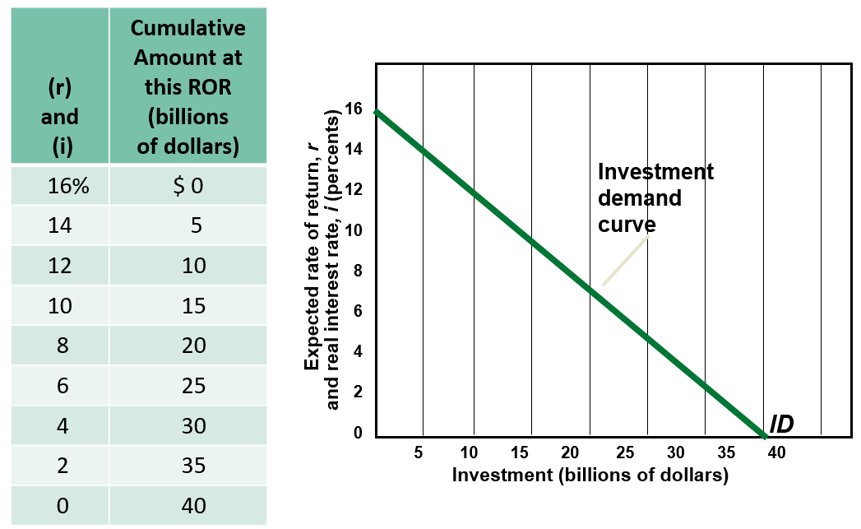
Investment Demand Curve LO 3
Notes:
This figure, which can be found in the Key Graph section, shows the investment demand curve. The investment demand curve is constructed by arraying all potential investment projects in descending order of their expected rates of return. The curve slopes downward, reflecting an inverse relationship between the real interest rate (the financial “price” of each dollar of investing) and the quantity of investment demanded.

Slide 43
Shifts of Investment Demand LO 4
Acquisition, maintenance, and operating costs
Business taxes
Technological change
Stock of capital goods on hand
Planned inventory changes
Expectations
Notes:
Shifts in investment demand occur when any determinant apart from the interest rate changes. Greater expected returns create more investment demand, shifting the curve to the right. The reverse causes a leftward shift.
Changes in expected returns result because:
Acquisition, maintenance, and operating costs of capital goods may change. Higher costs lower the expected return.
Business taxes may change. Increased taxes lower the expected return.
Technology may change. Technological change often involves lower costs, which would increase expected returns.
Stock of capital goods on hand will affect new investment. If there is abundant idle capital on hand because of weak demand or recent investment, new investments would be less profitable.
If firms are planning on increasing their inventories, investment demand shifts to the right. If firms are planning to decrease their inventories, investment demand shifts left. These planned inventory changes are based on expectations of either faster or slower sales. If the firm expects faster sales in the future, they will add to inventory. If the firm expects slower sales in the future, they will decrease inventories.
Expectations about future economic and political conditions, both in the aggregate and in certain specific markets, can change the view of expected profits.

Slide 44
Shifts of Investment Demand
Acquisition, maintenance, and operating costs
The initial costs of capital goods, and the estimated costs of operating and maintaining those goods, affect the expected rate of return on investment. When these costs rise, the expected rate of return from prospective investment projects falls and the investment demand curve shifts to the left.
Example: Higher electricity costs associated with operating tools and machinery shifts the investment demand curve to the left. Lower costs, in contrast, shift it to the right.

Slide 45
Business taxes
When government is considered, firms look to expected returns after taxes in making their investment decisions. An increase in business taxes lowers the expected profitability of investments and shifts the investment demand curve to the left; a reduction of business taxes shifts it to the right.

Slide 46
Technological change
Technological progress—the development of new products, improvements in existing products, and the creation of new machinery and production processes—stimulates investment.
A rapid rate of technological progress shifts the investment demand curve to the right.

Slide 47
Stock of capital goods on hand
The stock of capital goods on hand, relative to output and sales, influences investment decisions by firms. When the economy is overstocked with production facilities and when firms have excessive inventories of finished goods, the expected rate of return on new investment declines.

Slide 48
Expectations
We noted that business investment is based on expected returns (expected additions to profit). Most capital goods are durable, with a life expectancy of 10 or 20 years. Thus, the expected rate of return on capital investment depends on the firm’s expectations of future sales, future operating costs, and future profitability of the product that the capital helps produce.

Slide 49
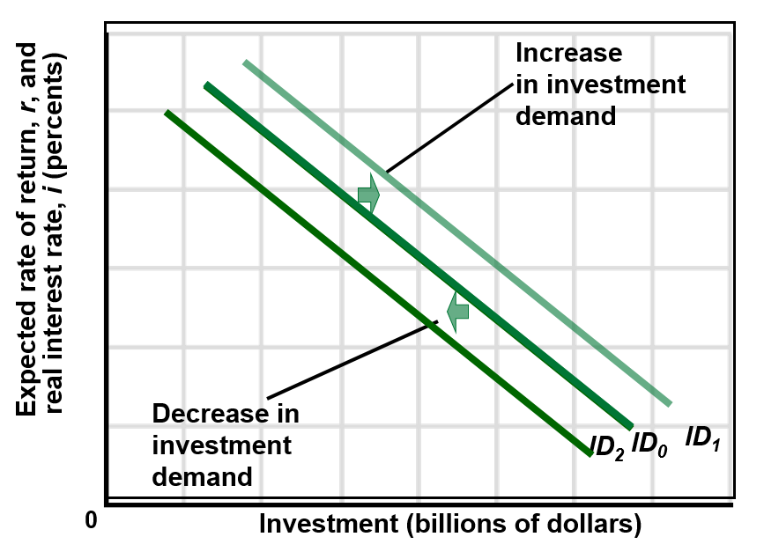
Shifts of Investment Demand Curve LO 4
Notes:
This figure shows the shifts of the investment demand curve. Increases in investment demand are shown as rightward shifts of the investment demand curve; decreases in investment demand are shown as leftward shifts of the investment demand curve.

Slide 50
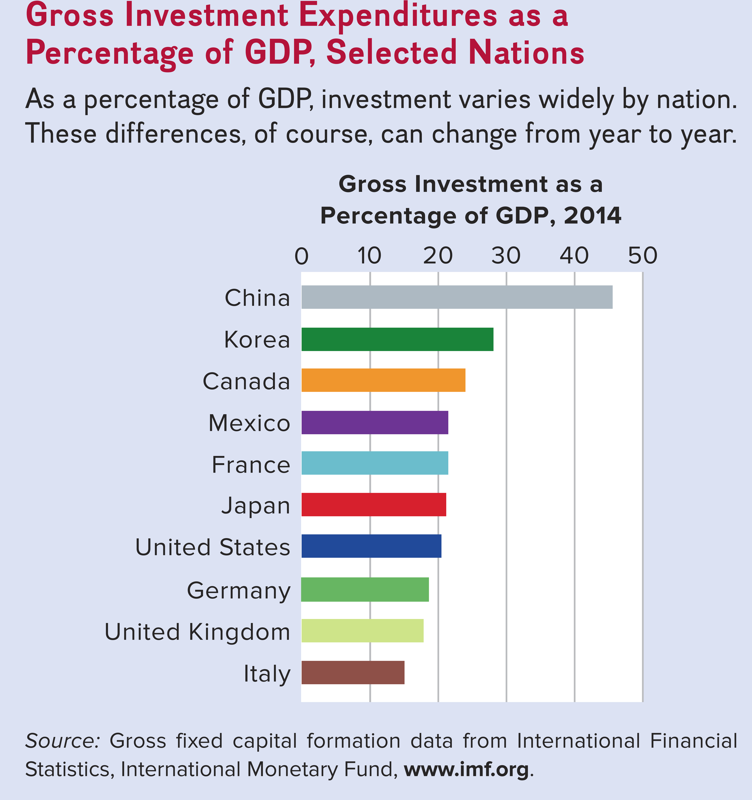
Global Perspective 2 LO 4
Notes:
This Global Perspective shows gross investment expenditures as a percentage of GDP for selected nations for 2014. As a percentage of GDP, investment varies widely by nation. These differences, of course, can change from year to year.

Slide 51
Instability of Investment
In contrast to consumption, investment is unstable; it rises and falls quite often. Investment, in fact, is the most volatile component of total spending—so much so that most of the fluctuations in output and employment that happen over the course of the business cycle can be attributed to demand shocks relating to unexpected increases and decreases in investment.

Slide 52
Volatility of Investment LO 4
Notes:
This figure shows the volatility of investment for the period 1976–2015. Annual percentage changes in investment spending are often several times greater than the percentage changes in GDP. (Data is represented in real terms. Investment is gross private domestic investment).

Slide 53
Instability of Investment LO 4
Variability of expectations
Durability
Irregularity of innovation
Variability of profits
Notes:
Investment is a very unstable type of spending. I_{g} is more volatile than GDP. Expectations of future business conditions are easily and quickly changed. Capital goods are durable, so spending can be postponed or not. Firms can choose to replace or fix older equipment and buildings. This is unpredictable. Innovation occurs irregularly; new products stimulate investment and create waves of investment spending that in time recede. Profits affect both the incentive and ability to invest and profits vary considerably from year-to-year, contributing to the instability of investment spending.

Slide 54
Variability of expectations
Variability of expectations
Business expectations can change quickly when some event suggests a significant possible change in future business conditions. Changes in exchange rates, trade barriers, legislative actions, stock market prices, government economic policies, the outlook for war or peace, court decisions in key labor or antitrust cases, and a host of similar considerations may cause substantial shifts in business expectations.

Slide 55

Price Adjustment with New Information
At 10AM EST, the U.S. Supreme Court refused to hear an appeal from MSFT regarding its anti-trust case. The stock immediately dropped. This example, one of hundreds available every day, illustrates that prices adjust extremely rapidly to new information.
But, did the price adjust correctly? Only time will tell, but it does seem that over the next hour the market is searching for the correct level.
Notes: Each bar represents high, low, and close for one-minute. Each solid gridline represents the top of an hour, and each dotted gridline represents a half-hour.
Notes:
This intra-day chart shows that prices react almost instantaneously to new information. Notice that just before the news was announced, the stock was trading around $56.75. Then, at 10 AM EST after the news, it dropped instantly to $54.13 (a loss of $2.62, or 4.6%). It quickly recovered, however, to around $56.25. Nobody can know what the correct price level is, but the market seems to be searching for it. This decision was widely expected, but the timing of the announcement was unknown.

Slide 56
Durability
Optimism about the future may prompt firms to replace their older facilities and such modernizing will call for a high level of investment. A less optimistic view, however, may lead to smaller amounts of investment as firms repair older facilities and keep them in use.

Slide 57
Irregularity of innovation
New products and processes stimulate investment. Major innovations such as railroads, electricity, airplanes, automobiles, computers, the Internet, and cell phones induce vast upsurges or “waves” of investment spending that in time recede. But such innovations occur quite irregularly, adding to the volatility of investment.

Slide 58
Variability of profits
High current profits often generate optimism about the future profitability of new investments, whereas low current profits or losses spawn considerable doubt about the wisdom of new investments.
Additionally, firms often save a portion of current profits as retained earnings and use these funds (as well as borrowed funds) to finance new investments.

Slide 59
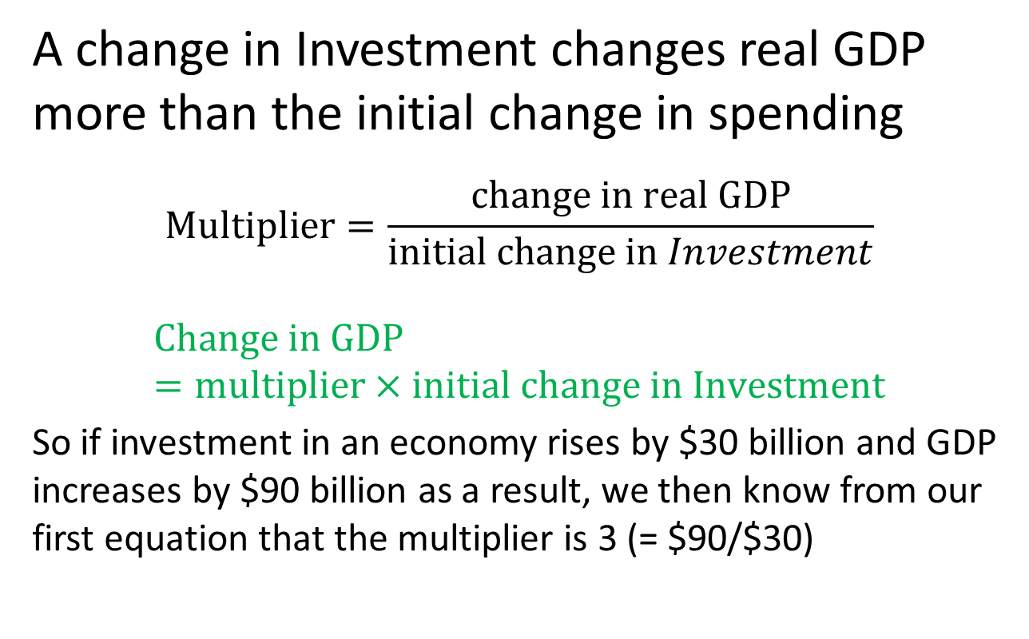
The Multiplier Effect 1 of 2
LO 5
A change in Investment changes real GDP more than the initial change in spending
$$Multiplier=\frac{change in real GDP}{initial change in Investment}$$
$$Change in GDP=multiplier×initial change in Investment$$
So if investment in an economy rises by $30 billion and GDP increases by $90 billion as a result, we then know from our first equation that the multiplier is 3 (= $90/$30)
Notes:
Changes in spending ripple through the economy to generate even larger changes in real GDP. This is called the multiplier effect.
Multiplier = change in real GDP / initial change in spending. Alternatively, it can be rearranged to read: change in real GDP = initial change in spending × multiplier.
Points to remember about the multiplier:
The initial change in spending is usually associated with investment because it is so volatile, but changes in consumption (unrelated to income), net exports, and government purchases also are subject to the multiplier effect.
The initial change refers to an up-shift or down-shift in the aggregate expenditures schedule due to a change in one of its components, like investment.
The multiplier works in both directions (up or down).
It occurs because of the interconnectedness of the economy.

Slide 60
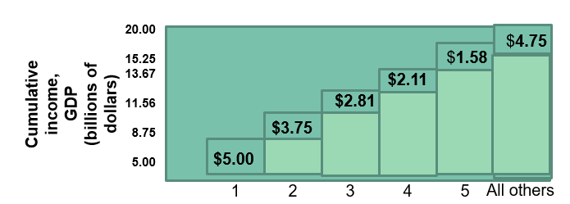
The Multiplier Effect 2 of 2
LO 5
 | (1) Change in Income | (2) Change in Consumption (MPC = .75) | (3) Change in Saving (MPS = .25)
Increase in investment of $5.00 | $5.00 | $3.75 | $1.25
Second round | 3.75 | 2.81 | .94
Third round | 2.81 | 2.11 | .70
Fourth round | 2.11 | 1.58 | .53
Fifth round | 1.58 | 1.19 | .39
All other rounds | 4.75 | 3.56 | 1.19
Total | $20.00 | $15.00 | $5.00
Notes:
This figure illustrates the multiplier process with an MPC of .75. An initial change in investment spending of $5 billion creates an equal $5 billion of new income in round 1. Households spend $3.75 billion of this new income, creating $3.75 of added income in round 2. Of this $3.75 of new income, households spend $2.81 billion, and income rises by that amount in round 3. Such income increments over the entire process get successively smaller but eventually produce a total change of income and GDP of $20 billion. The multiplier therefore is 4.

Slide 61
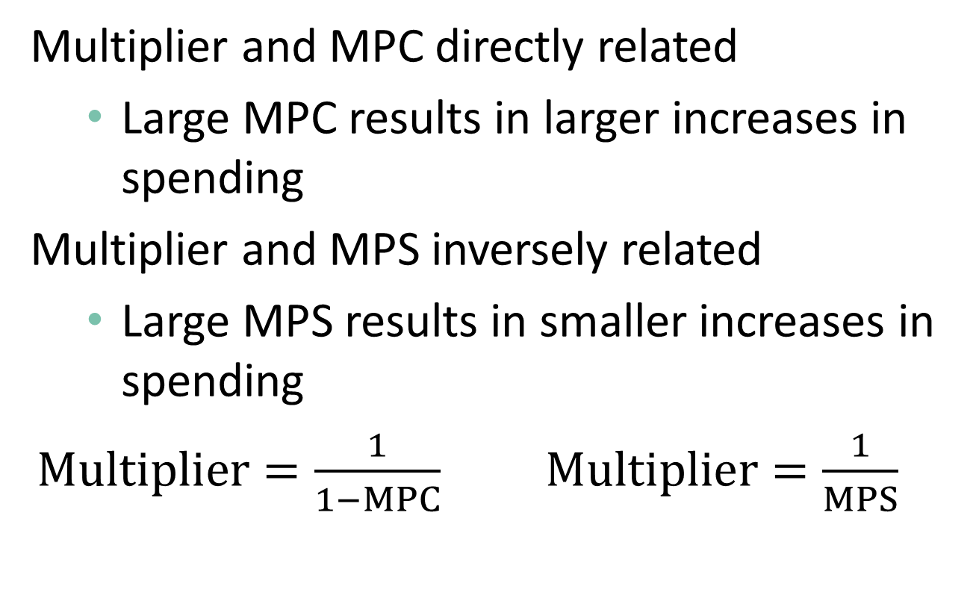
Multiplier and Marginal Propensities 1 of 2 LO 5
Multiplier and MPC directly related
  Large MPC results in larger increases in spending
Multiplier and MPS inversely related
  Large MPS results in smaller increases in spending
  $Multiplier=\frac{1}{1−MPC}$ $Multiplier=\frac{1}{MPS}$
Notes:
The significance of the multiplier is that a small change in investment plans or consumption-saving plans can trigger a much larger change in the equilibrium level of GDP. The magnitude of the change in GDP is dependent on the size of the MPC and MPS.

Slide 62
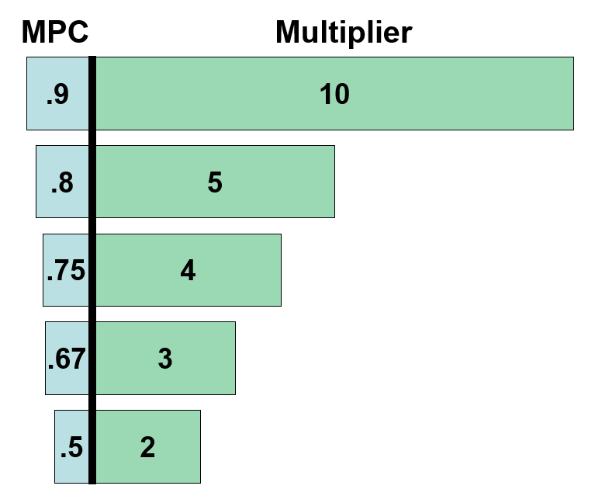
Multiplier and Marginal Propensities 2 of 2 LO 5
Notes:
This figure illustrates the relationship between the MPC and the multiplier. The larger the MPC (the smaller the MPS), the greater the size of the multiplier.

Slide 63
Multiplier Effects
A decline in spending begins a chain of declines, or, in other words, the initial decrease in spending is multiplied in terms of the final effect of this single decision.
This occurs because of the observation that any change in income causes a change in spending that is directly proportional to it.
The multiplier effect helps us understand why there is a business cycle as opposed to a stable level of output growth from year to year.

Slide 64
The multiplier is based on two facts:
1. The economy has continuous flows of expenditures and income — a ripple effect — in which income received by one comes from money spent by another, and so forth.
2. Any change in income will cause both consumption and saving to vary in the same direction as the initial change in income.

Slide 65
Squaring the Economic Circle
Humorous small town example of the multiplier
One person in town decides not to buy a product
Creates a ripple effect of people not spending, following the first decision
Ultimately the entire town experiences an economic downturn
Notes:
The central idea illustrated in this example is of the multiplier effect that exists in a market economic system. One independently determined change in spending has an effect on another’s income, which then sets in motion a chain of events whereby spending changes directly with the income changes. A decline in spending begins a chain of declines, or, in other words, the initial decrease in spending is multiplied in terms of the final effect of this single decision. This occurs because of the observation that any change in income causes a change in spending that is directly proportional to it. The multiplier effect helps us understand why there is a business cycle as opposed to a stable level of output growth from year to year. In the Buchwald piece, a “downturn” for one person became a downturn for everyone in that fictional economy. Likewise, if the story had begun with a burst of optimism and an increase in spending, it might have rippled through to expand everyone’s fortunes.
The multiplier intensifies the effect of a spending change, whether it is an increase or decrease.
The multiplier is based on two facts:
1. The economy has continuous flows of expenditures and income — a ripple effect — in which income received by one comes from money spent by another, and so forth.
2. Any change in income will cause both consumption and saving to vary in the same direction as the initial change in income.

